Slide 1
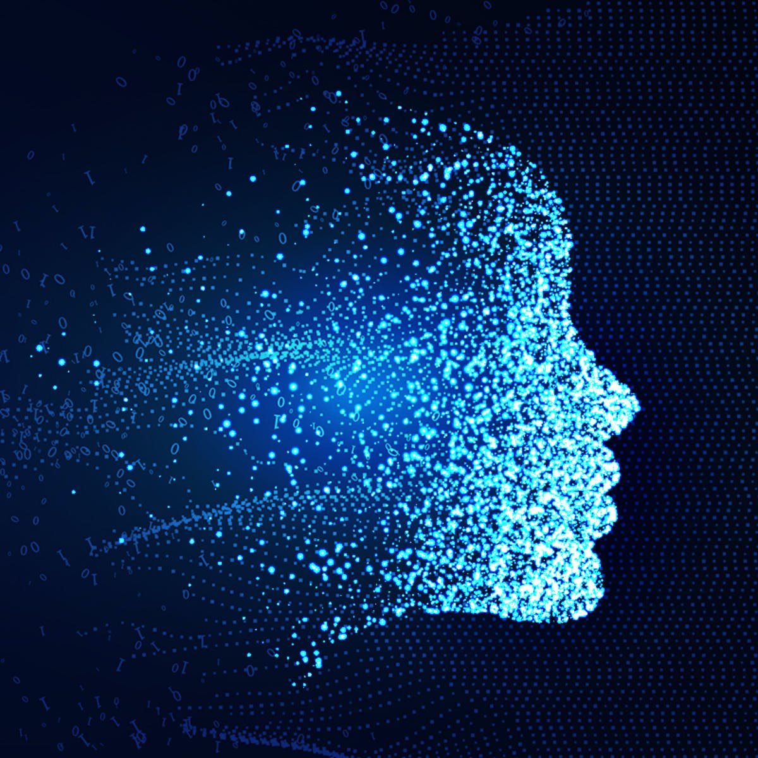
Computational Thinking in Schools
Dr. Moses Satralkar
Vidyashilp University, Edu-Connect Conference
17-06-22

Slide 2
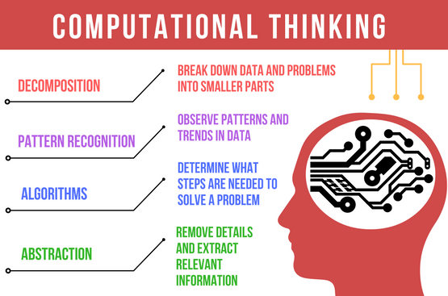
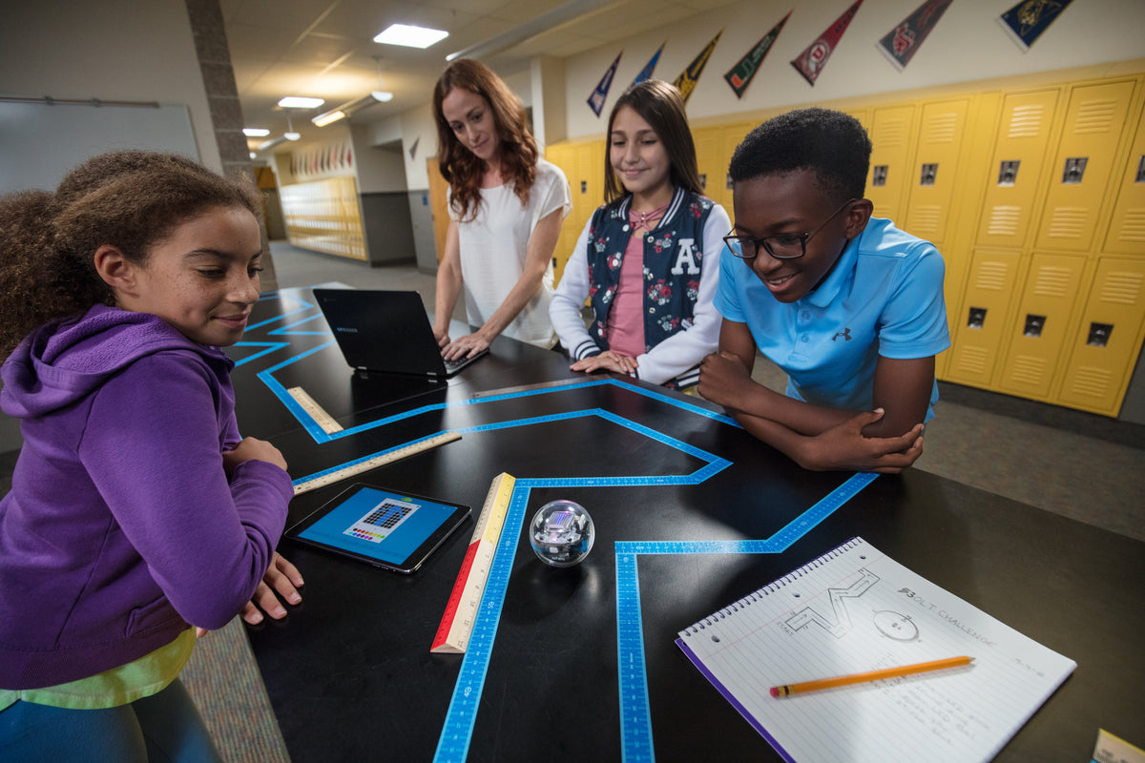
Computational Thinking
Computational Thinking is an approach to problem solving which can be transferred to a computer. This provides a vital link between the creativity and flexibility of the human brain, and the speed and efficiency of computational power, and is therefore a key skill in the digital era. It enables a human to think like a computer.
Curricula focused on problem-solving, coding, and STEM subjects help prepare students to address future challenges. To give students the best start possible, schools are looking to help them develop a toolkit of technical skills.
Computational thinking provides the problem-solving skills and sequences in the digital world. It's powerful when integrated into the curriculum because students engage in experiential learning of content-related problems, such as how to identify the tone of a story or how to best address pollution in their local area.
Seymour Papert, credited with being the first to use the term computational thinking, is a mathematician and co-founder of the Artificial Intelligence Lab at MIT. The first children's toys with built-in computation were created in his own laboratory in the sixties. The term computational thinking was first formally introduced by Jeannette Wing in 2006 and better defined in 2008 [1,11]. In her seminal paper, she proposed a “universally applicable attitude and skill set” to utilize “abstraction and decomposition” to tackle complex tasks with the mindset of a computer scientist.
https://teachyourkidscode.com/what-is-computational-thinking/

Slide 3
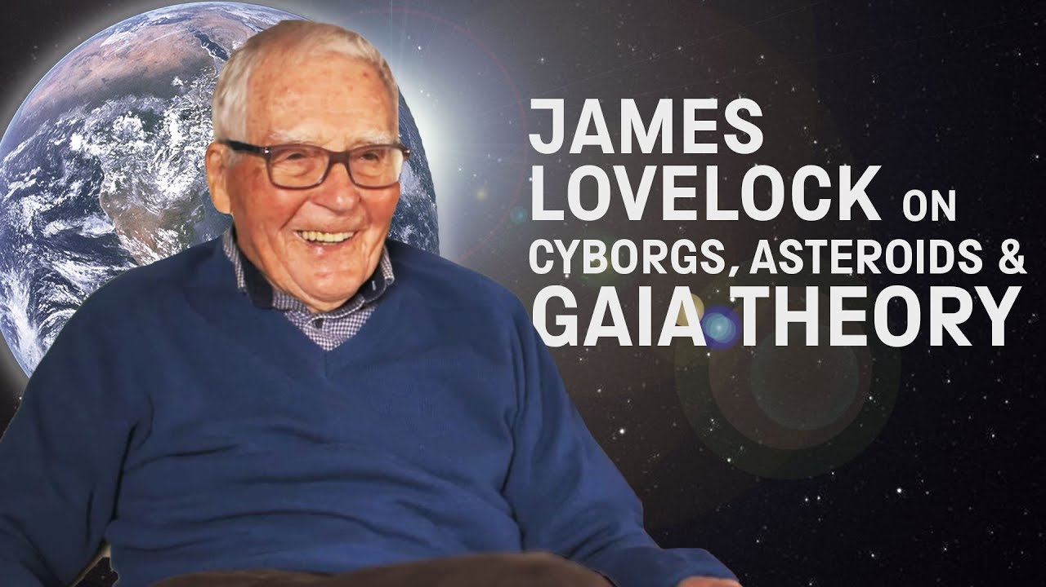
Interface between CT and AI Humans thinking like machines (CT) and machines thinking like humans (AI) – Inextricably Linked “Anthropocene” – the era in which humans became able to make large-scale alterations to the planetary environment “Novacene” – The new age will be marked by the unpredictable marvels to be unleashed by hyperintelligent robots (“cyborgs”) and the AI Takeover James Lovelock, 2019

Slide 4
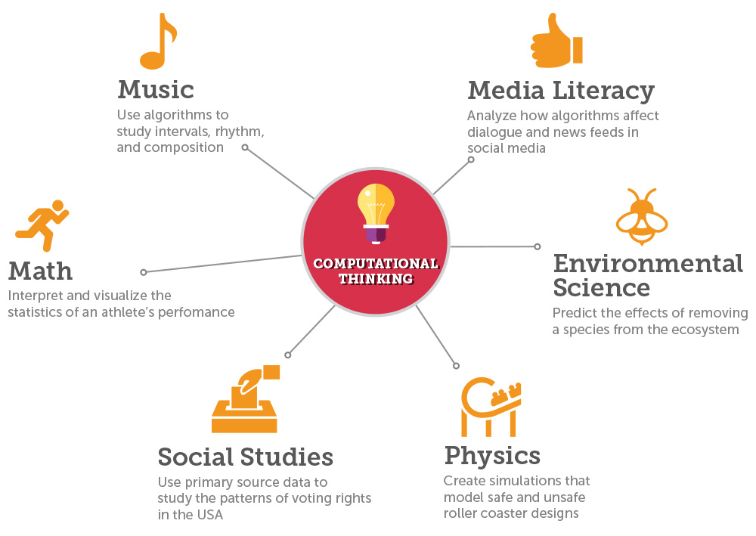
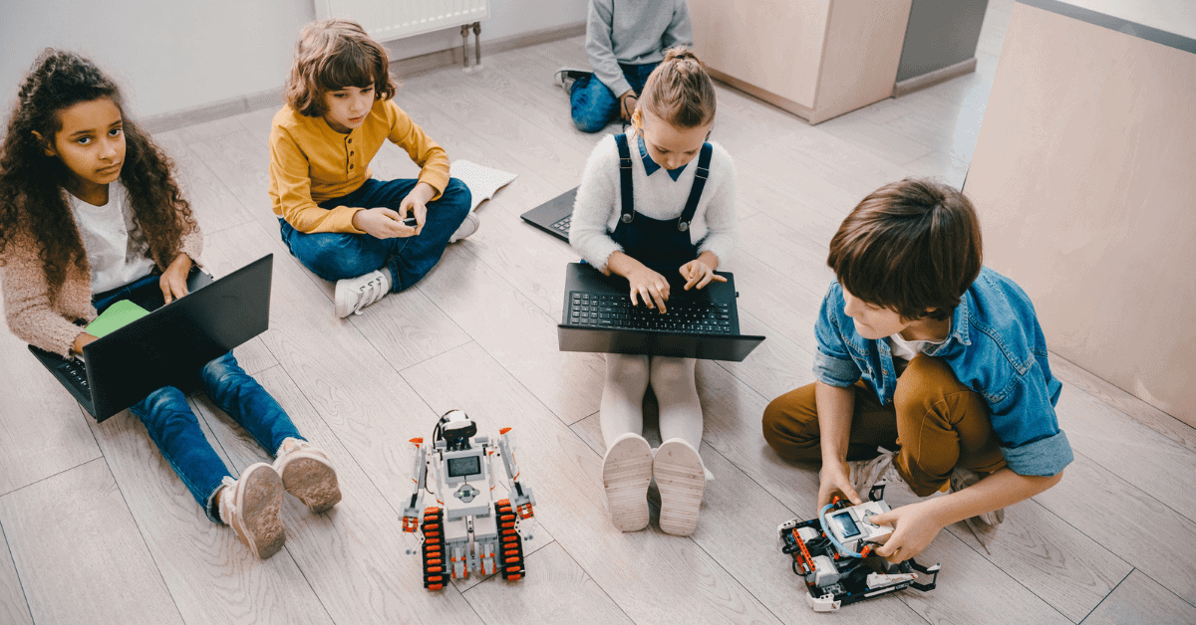
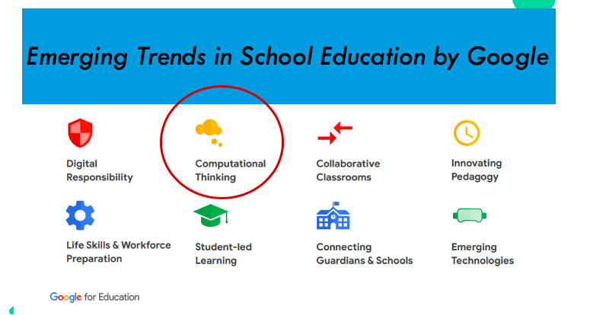
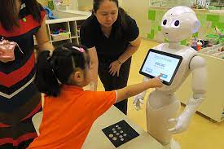
Future Trends in Education Teaching CT in Schools

Slide 5
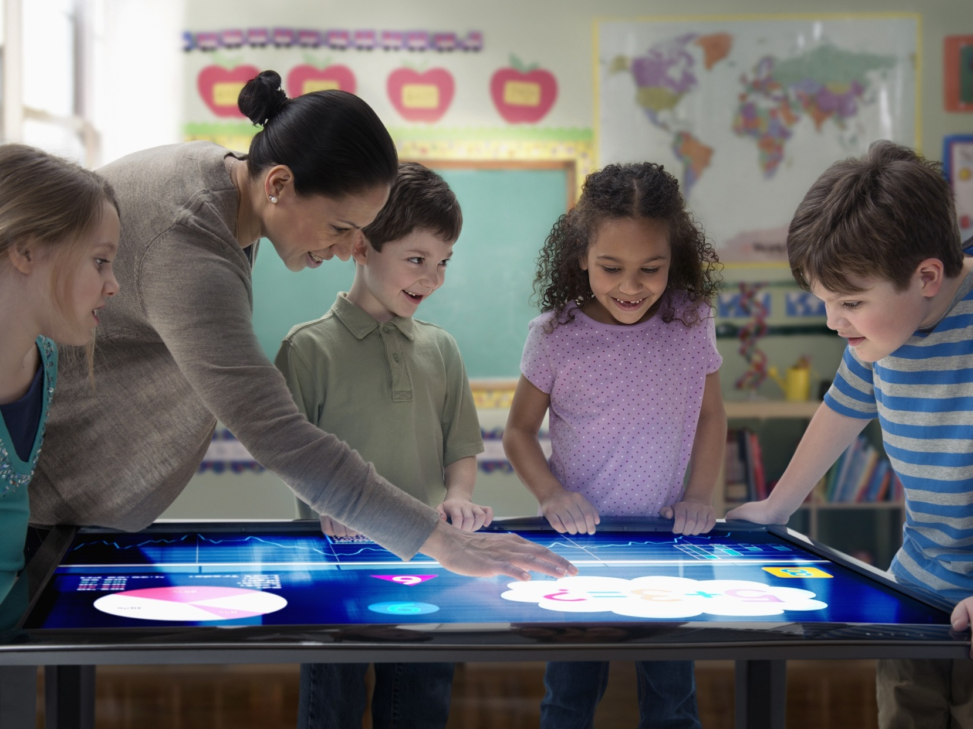
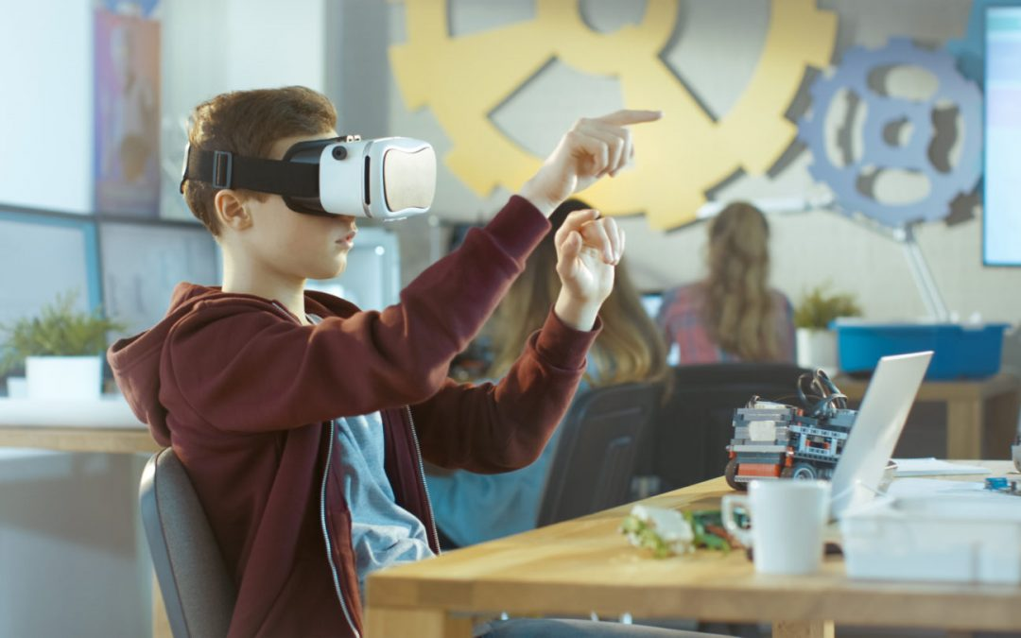
Significance of new Inventions and CT in the Classroom
Innovations in newly developed artificially intelligent (AI) systems combined with the power of Computational Intelligence in Classrooms enhance differential learning styles, cognitive abilities, degree of focus, attention span, inferential and literal memory, logical reasoning abilities and enhance conceptual thinking, creativity, IQ, EQ and overall left-right (logical-creative) brain development affecting personality in children as young as 2 and 3 yrs of age. Neuroscience by Eric Jensen & Studies by Marshall McLuhan

Slide 6
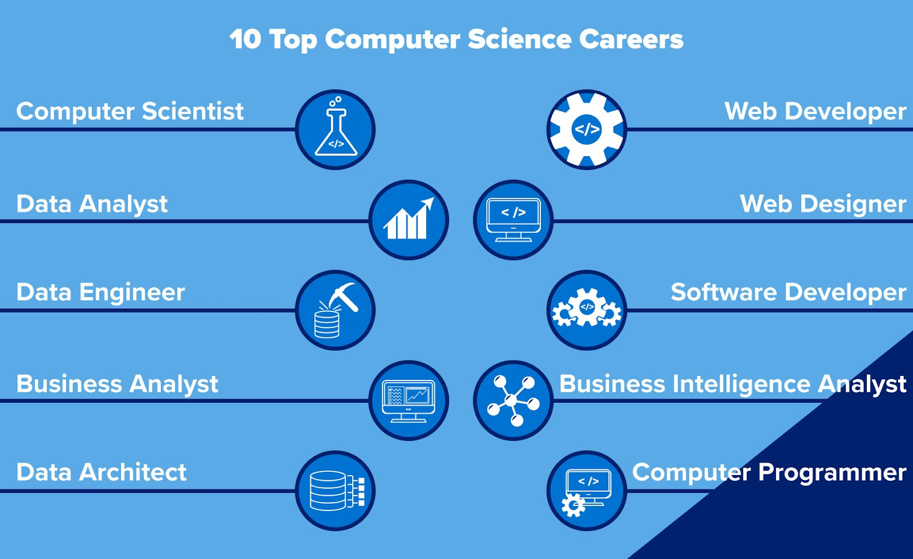
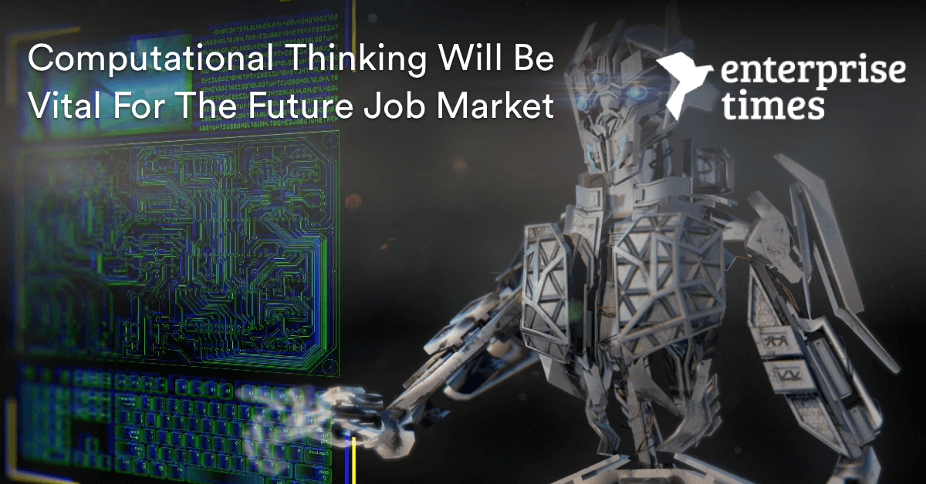
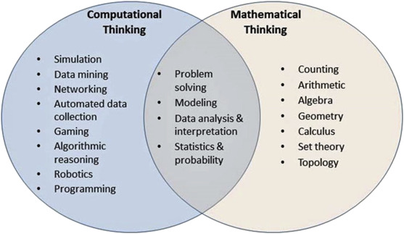
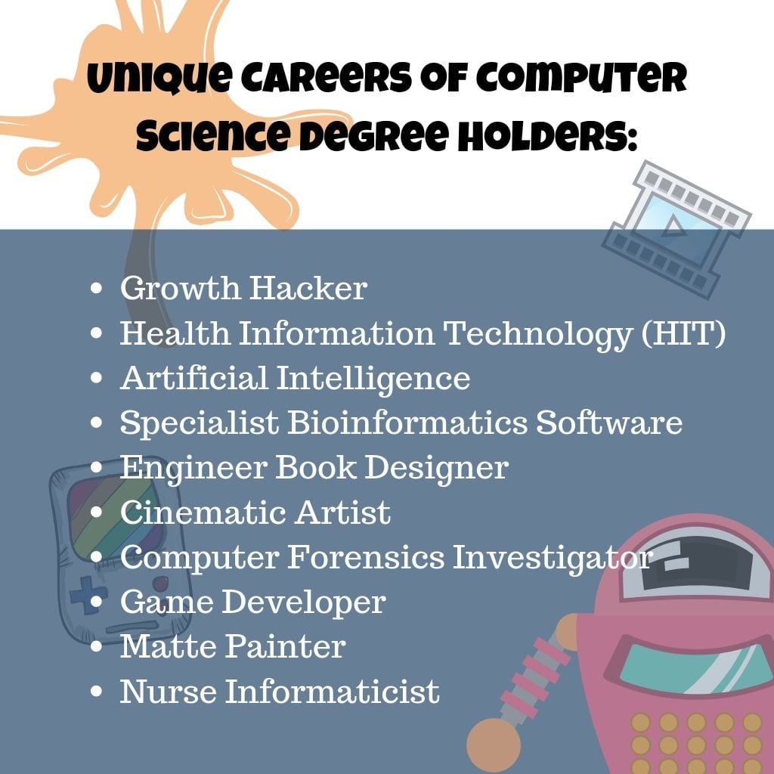
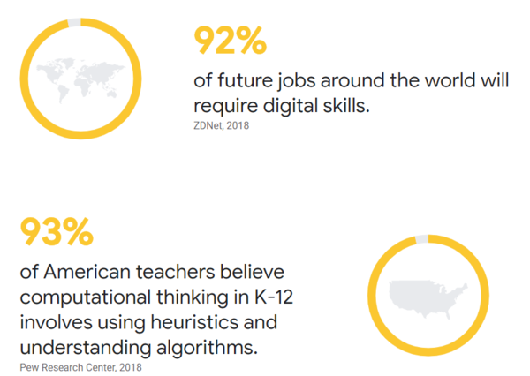
Scope and Careers with CT

Slide 7
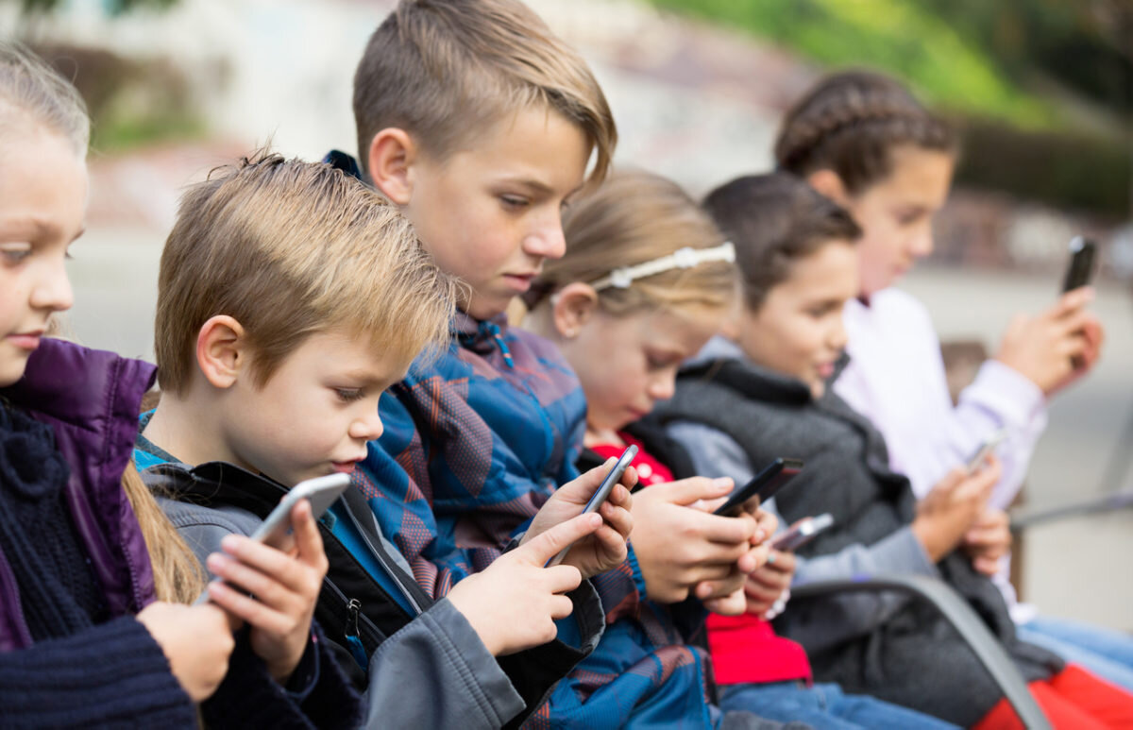
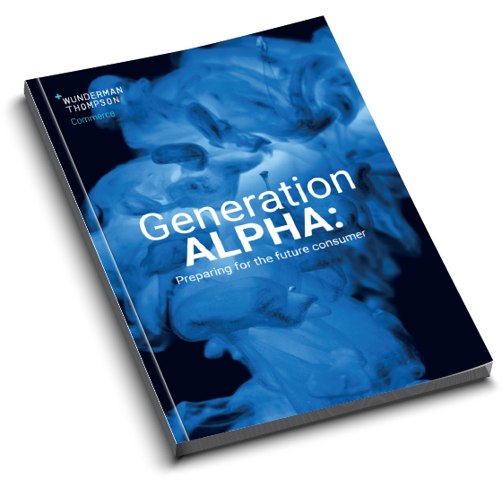
Alpha Kids are pro-CT
The term “Generation Alpha” refers to the group of individuals born between 2010 and 2025. These are children of the Millennials. Mark McCridle
The Generation Alpha generation prefers text and not human-to-human communication; they are also the most globally connected generation of children ever, due to Technology and Internet
These Children are Digital Natives, Technology Minded and Techh-Savvy. They grow up with Alexa, Siri, and Mobile Apps as Toys during Childhood. Due to the ecosystem they are programmed towards CT.
There are already 2 billion Alpha kids in the world
They will probably be the most economically successful generation
https://mccrindle.com.au/insights/blogarchive/gen-z-and-gen-alpha-infographic-update/ Mark McCridle

Slide 8
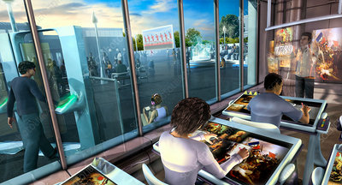
Paradigm Shift in Schools
Vocabulary for Life – Language of Syllabus and Language of Computation is different
Education that transitions from Industrial Revolution to Innovative Revolution. Cultural and Societal shift with Competency based Curriculum in Schools
Less of a traditional view of Schools and Teachers; Exponential Technologies, AI run Schools, Mixed Reality, Blended Learning Ecosystems; Life Coaches, Mentors
Personalized Learning, Algorithm based courses, Mathematical modelling, MOOC Courses, Expeditionary Learning, Blockchains
Children do not go to School, the School goes to Children. Schools will teach what Google Cannot Teach; Self-directed Learning, Relearning and Unlearning
Assessments which are on a Competitive mode will move to Innovative Mode
Dual Schooling and Dual Degrees for improved Personalities, Academics and Careers
46% of Jobs today will be obsolete due to automation in the next 15 yrs. 56% workers need to reskill and 7 out 10 will be in VUCA jobs; Rapid rate of acceleration change; DAVOS Report (India is top exporter of Talent and Skills, Bangalore is IT Capital).

Slide 9
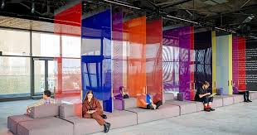
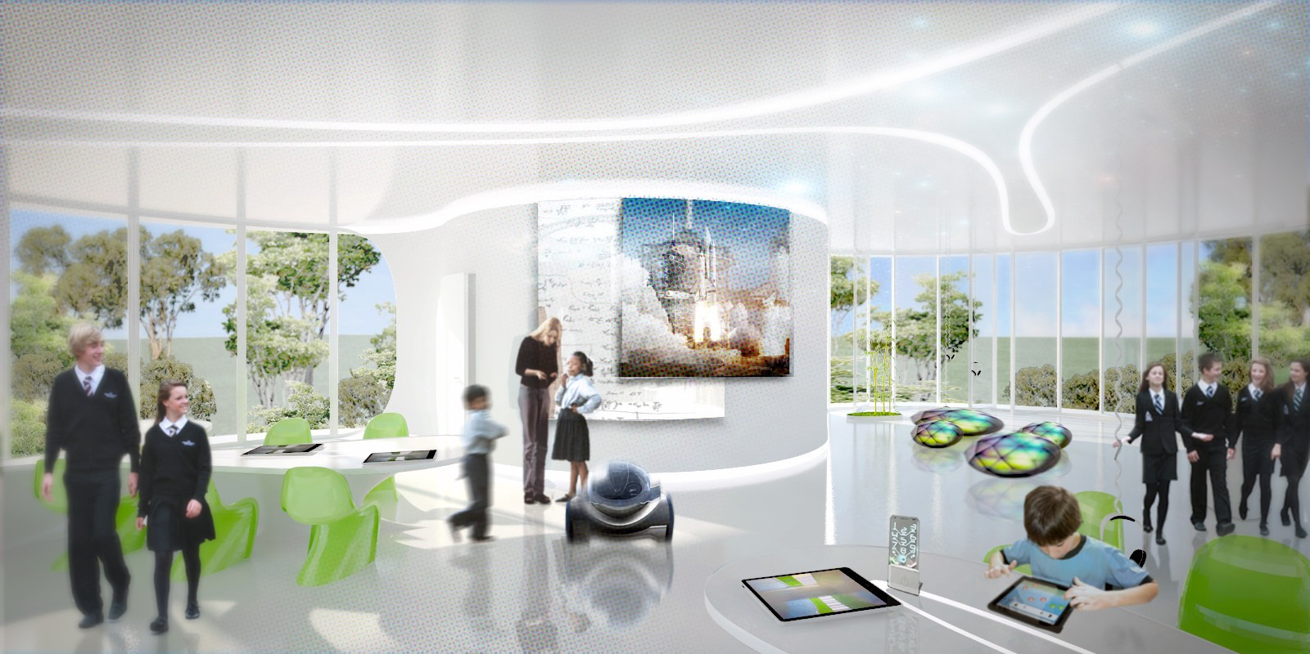
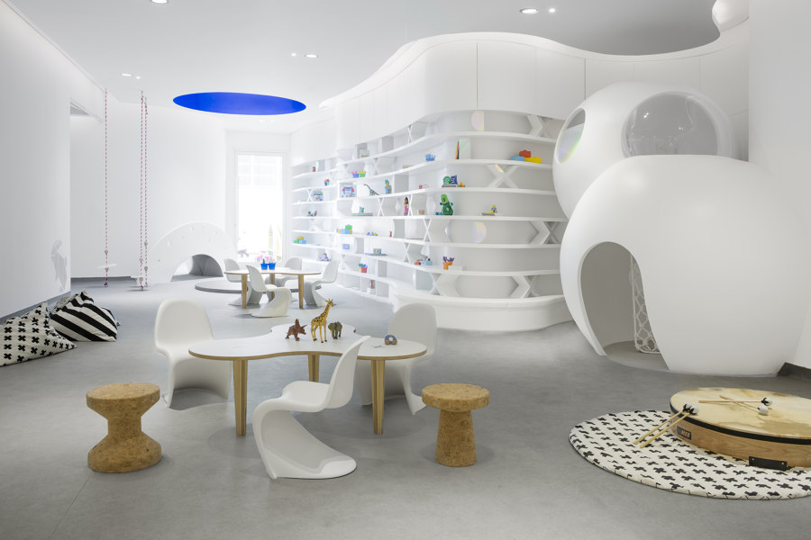
Computation
& Ecosystems
in Schools

Slide 10
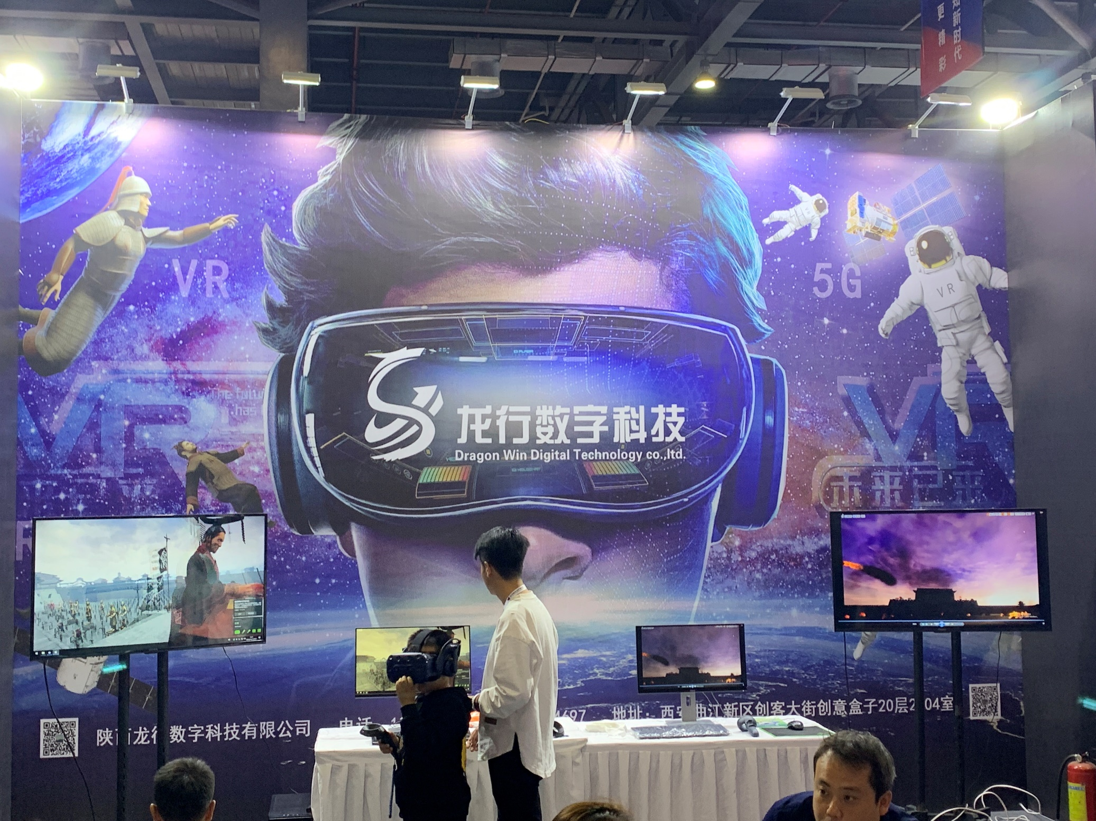
Computational Interfaces
AI Classrooms - IoT
Teleportation Devices
Mechatronics
AI Mirrors
Transmediation
Astral Projection
Holographic Imaging
Human-ware
Virtual Reality Labs
Augmented Reality Labs
Multi-Media
Game Based Learning Apps

Slide 11
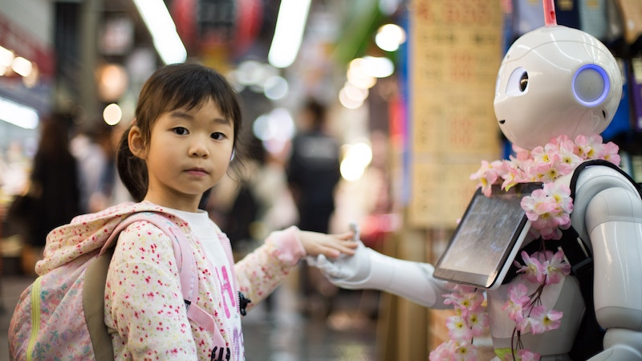
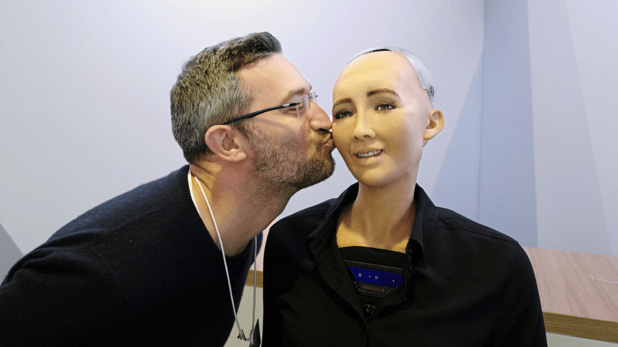
Only in recent decades has love fallen under the scrutiny of hard science, and is moving out of the domain of the humanities What is Love? Is there a Science to EQ and Love? Evolutionary Psychology Neurology Physiology Bio-Chemistry
Does CT make AI Ethical?
DR. HELEN FISHER
A biological anthropologist, a senior research fellow at The Kinsey Institute, and the Chief Scientific Advisor at Match.com
DR. ARTHUR ARON
A professor of psychology at Stony Brook, best known his famous 36 questions, and for identifying the neural circuits engaged by relationship-relevant cognitions and emotions
DR. LUCY L BROWN
Neuroscience of romantic love and attachment at Albert Einstein College of Medicine, and focuses on the function and neuroanatomy of the basal ganglia

Slide 12
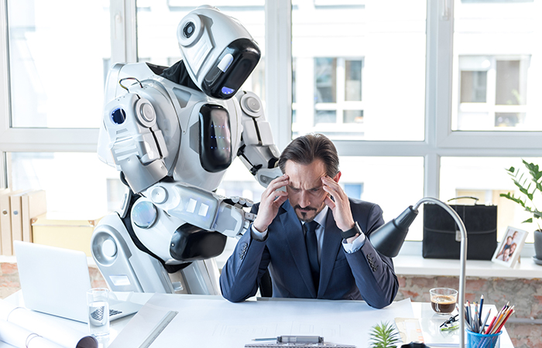
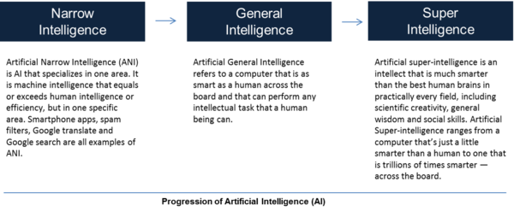
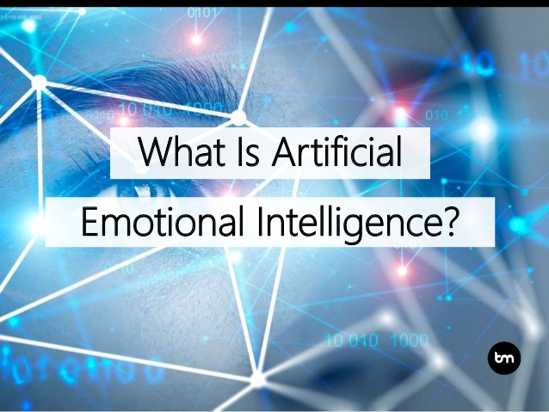
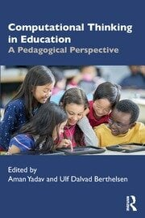
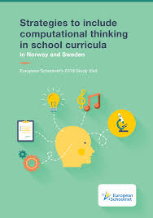
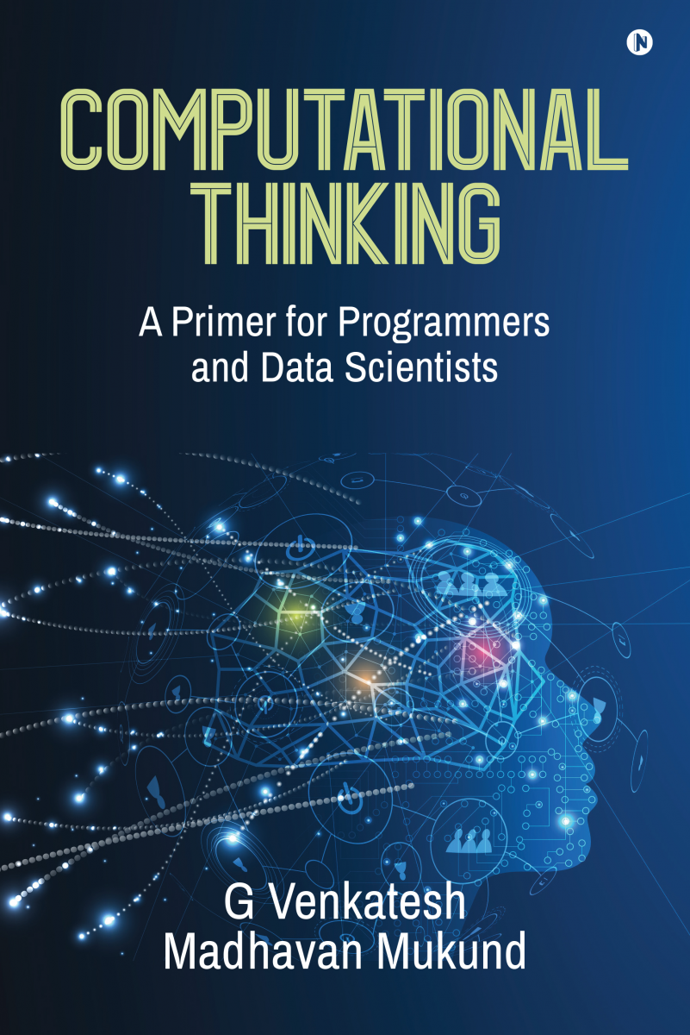
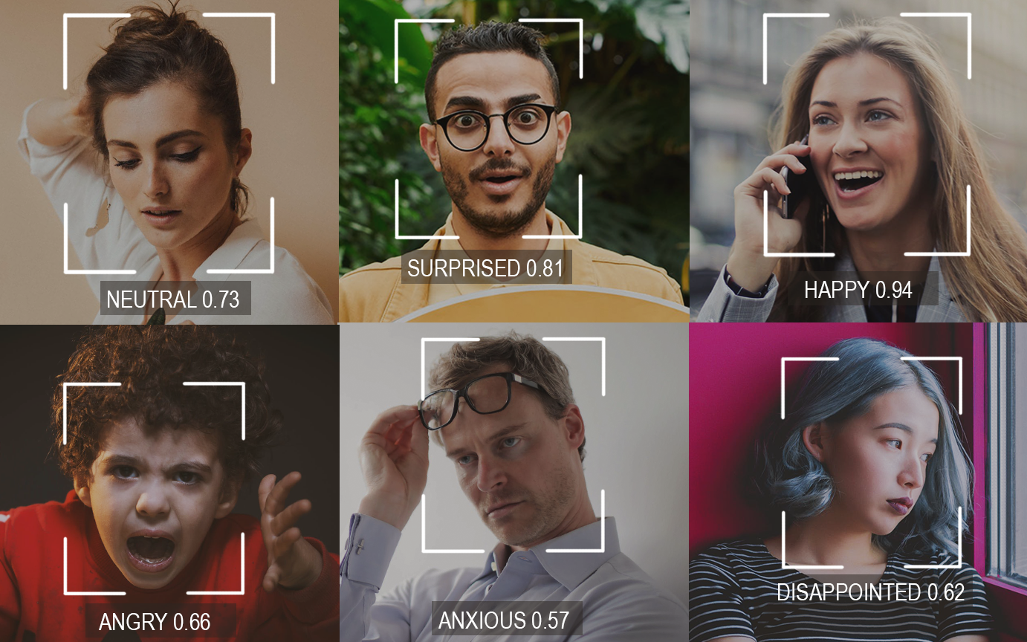
AGI and AEI

Slide 13
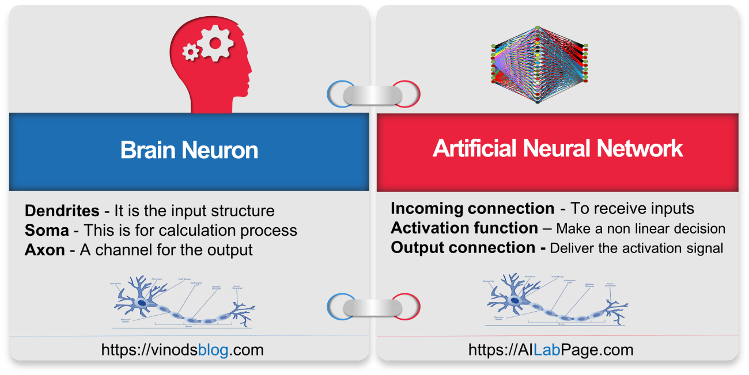
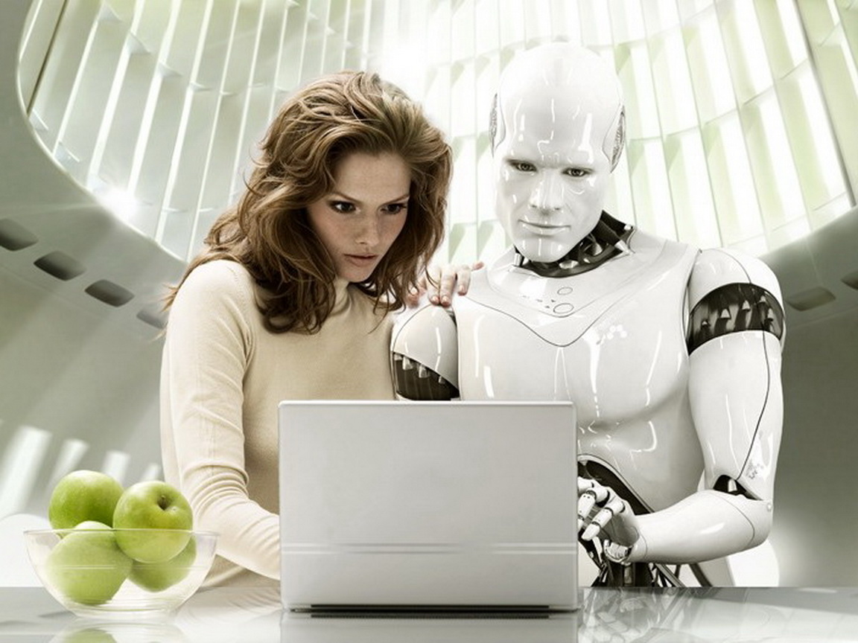
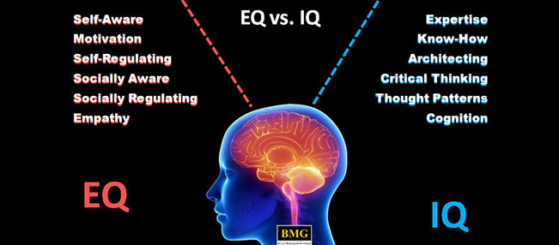
NEUROLOGY
NANOTECHNOLOGY
HUMANS
Thinking
Memory
Function
Behaviour
ROBOTS
Organic Neural Networks
Artificial Neural Networks
Eg: Google Brain

Slide 14
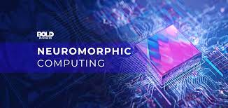
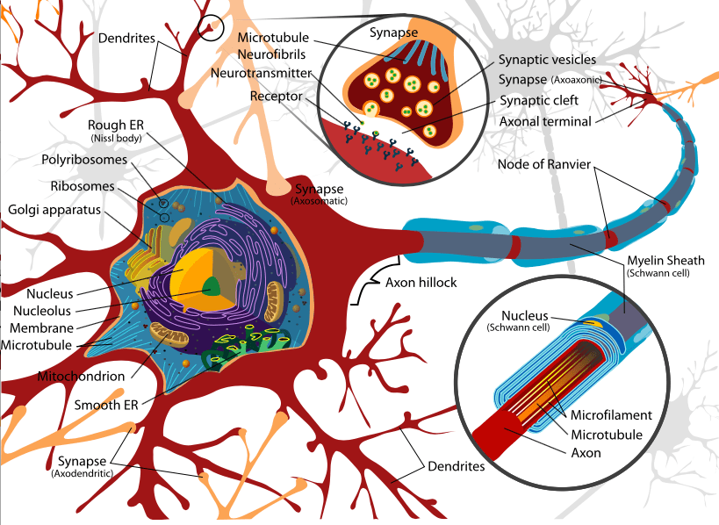
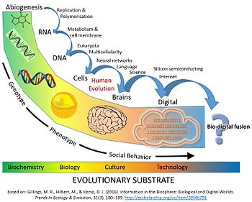
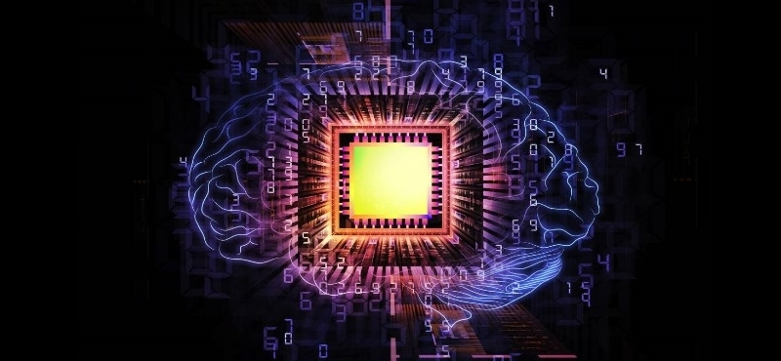
Biodigital Fusion : Neuromorphic Computing
The collective intelligence of people and computers when fused together can solve problems that not long ago were considered impossible. AI + Human Computational Intelligence = Innovative Intelligence
The computational building blocks within neuromorphic computing systems are logically analogous to neurons. Spiking neural networks (SNNs) are a novel model for arranging those elements to emulate natural neural networks that exist in biological brains
Bio-digital fusion will create a new human specimens as well relatively newer economic, natural and ethical issues

Slide 15
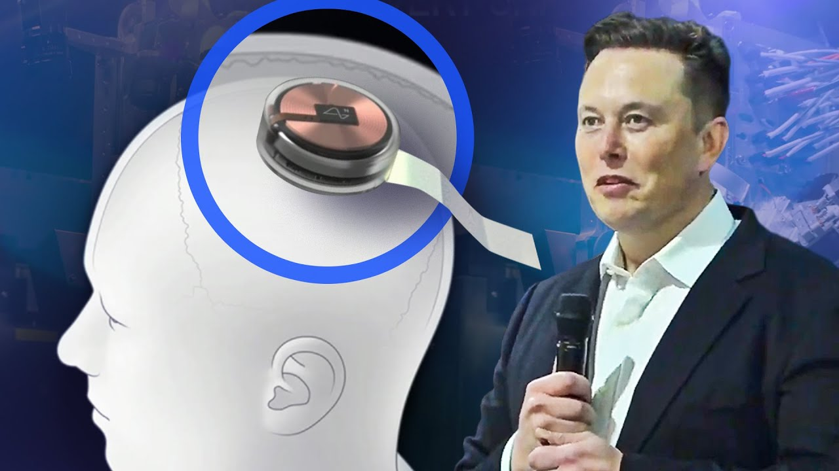
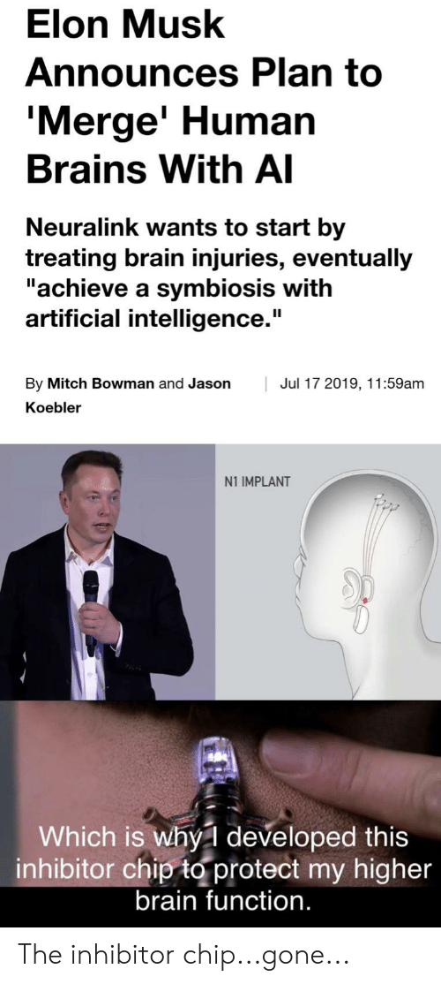
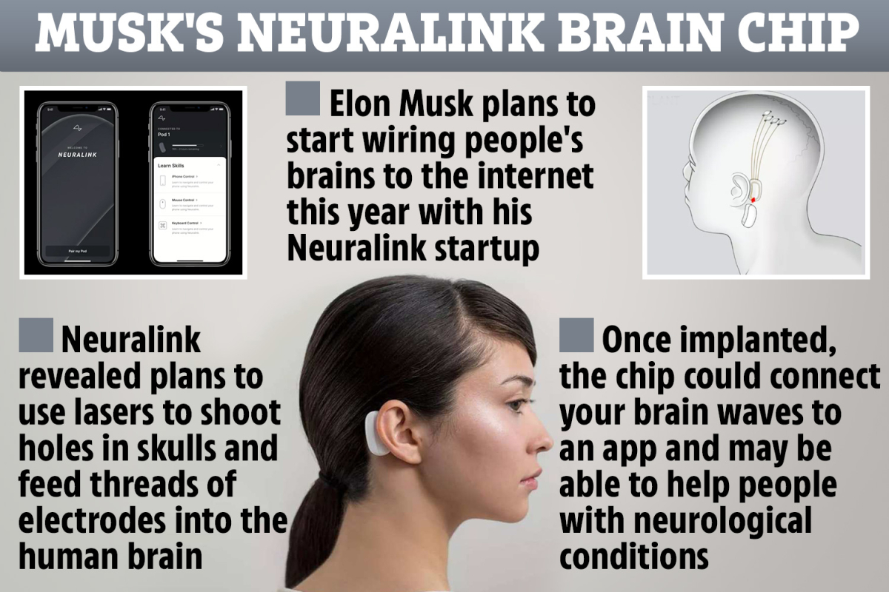
How Neuralink Works - YouTube

Slide 16
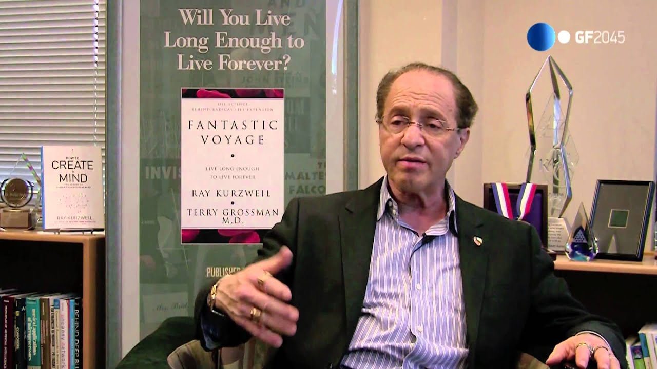
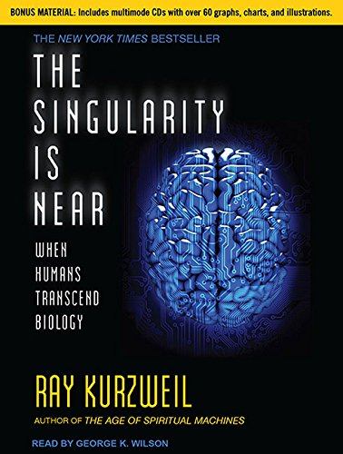
Age of Singularity
The Singularity is the hypothetical future creation of super intelligent machines or Cyborgs. The time when the abilities of a computer overtake the abilities of the human brain
The Oxford Dictionary defines the Singularity as “A hypothetical moment in time when artificial intelligence and other technologies have become so advanced that humanity undergoes a dramatic and irreversible change”…an event postulated at 2045!
Singularity assumes the speed of everything will increase faster, and faster, until it gets so fast that it is impossible for the Human Brain to comprehend information processing (we're simply not built for that kind of development), however, hyperintelligent machines networked through AI-Internet can cope with that kind of information processing, thereby giving them an evolutionary edge over humankind….Ray Kurzweil, 2005

Slide 17



